Slide 1

CREDX CASE STUDY
Cover Page

Slide 2
Problem Statement:
To provide the Bank with a model which can identify and calculate the risk associated with lending to different demographics of people.
Objective:
The aim of this project is to predict the likelihood of defaulter cases that may occur in the future for new credit borrowers based on output generated from models such as: The Classification Tree, Random Forest Model and Logistic Regression Analysis on current datasets.

Slide 3
APPROACH TO SOLUTION
1. Exploratory Data Analysis
2. Classification Model
4. Support Vector Machine Model
3. Random Forest Model

Slide 4
DATA UNDERSTANDING
For this project, we have used two interrelated datasets:
credit _bureau.csv
demogs.csv
credit_bureau.csv includes:
An ID for each customer
Performance tag (shows whether or not there was a default)
Data columns related to defaulters in the 30-, 60- and 90-days bucket (DPD) in the last 6 or 12 months
Number of existing home loans for each customer record
Outstanding balance for each customer record
Number of auto loans
Total number of trades
demogs.csv includes:
An ID for each customer
Performance tag (shows whether or not there was a default)
Age
Gender
Marital Status for each applicant
Number of Dependents
Income
Education
Profession
Duration in Profession
Type of Residence
Duration in Residence

Slide 5
DATA Preprocessing
We begin the initial Data exploration process by-
Performing EDA:
Merge both datasets
Check for
null values
duplicate values
Outliers
Visualize data to understand general trends and relationships
Perform WOE analysis
Perform IV analysis
2. Analysis Methods Used:
Logistic Regression Analysis
Random Forest
Support Vector Machine

Slide 6
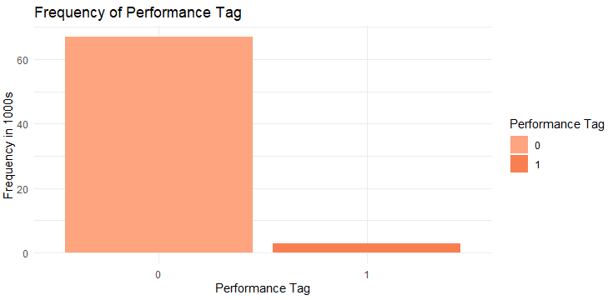
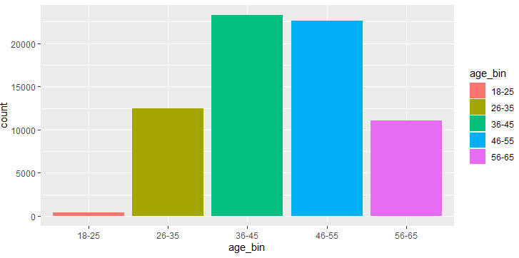
EDA-UNIVARIATE ANALYSIS
DEMOGRAPHIC DATA
An ID for each customer, Performance tag (shows whether there was a default), Age, Gender, Marital Status for each applicant, Number of Dependents , Income , Education, Profession, Duration in Profession, Type of Residence , Duration in Residence

Slide 7
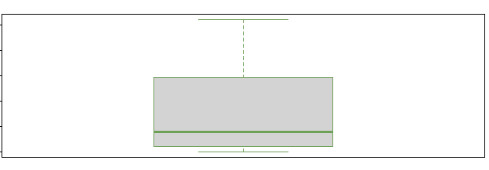
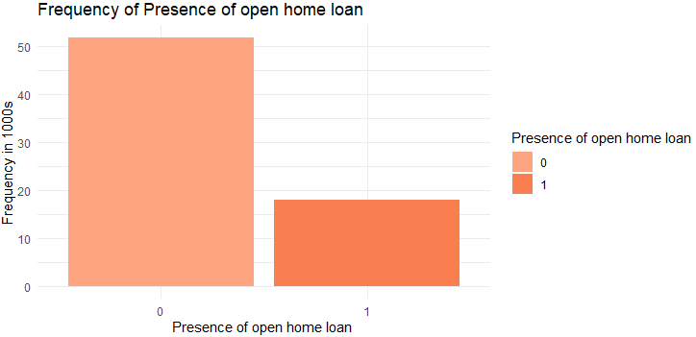
EDA-UNIVARIATE ANALYSIS
CREDIT DATA
An ID for each customer
Performance tag (shows whether or not there was a default)
Data columns related to defaulters in the 30-, 60- and 90-days bucket (DPD) in the last 6 or 12 months
Number of existing home loans for each customer record
Outstanding balance for each customer record
Number of auto loans , Total number of trades
Out Standing amount.
From the graph we can
conclude that maximum
observations are skewed
to the below average
outstanding amount which we can see
Median<Mean
Existing home
Open home
Loans :

Slide 8
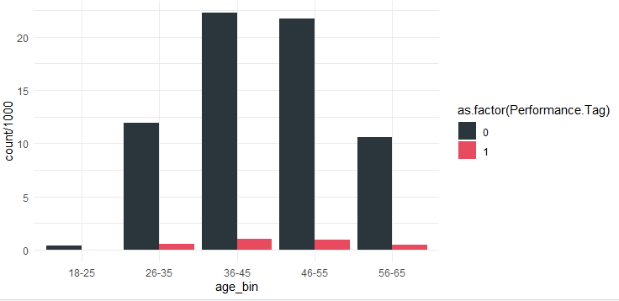
EDA-BIVARIATE ANALYSIS
DEMOGRAPHIC DATA
An ID for each customer, Performance tag (shows whether or not there was a default), Age, Gender, Marital Status for each applicant, Number of Dependents , Income , Education, Profession, Duration in Profession, Type of Residence , Duration in Residence
Conclusion: From the above plot we can conclude that default is high between 36 to 55 Age compare to Other groups but even population is also high

Slide 9
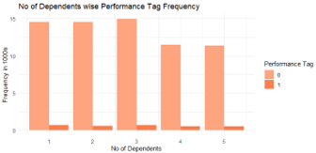
Conclusion : For Dependent 4 and 5 default rate is seen with less frequency of 12000 people.

Slide 10
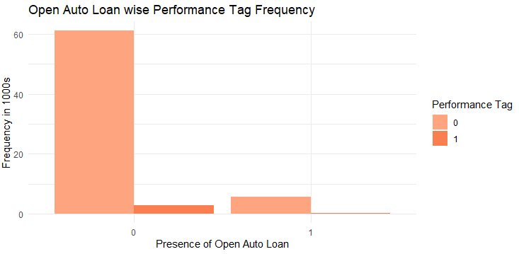
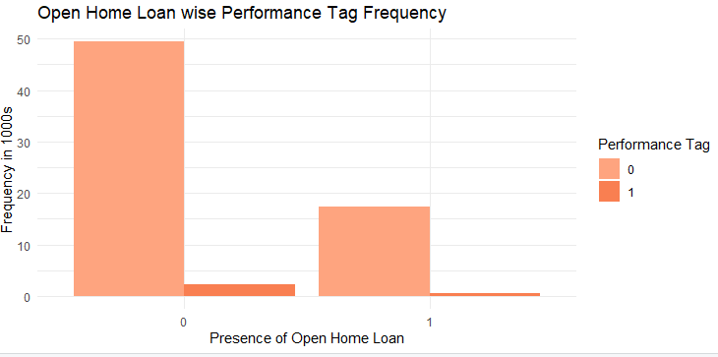
EDA-BIVARIATE ANALYSIS
CREDIT DATA
An ID for each customer
Performance tag (shows whether or not there was a default)
Data columns related to defaulters in the 30-, 60- and 90-days bucket (DPD) in the last 6 or 12 months
Number of existing home loans for each customer record
Outstanding balance for each customer record
Number of auto loans , Total number of trades

Slide 11
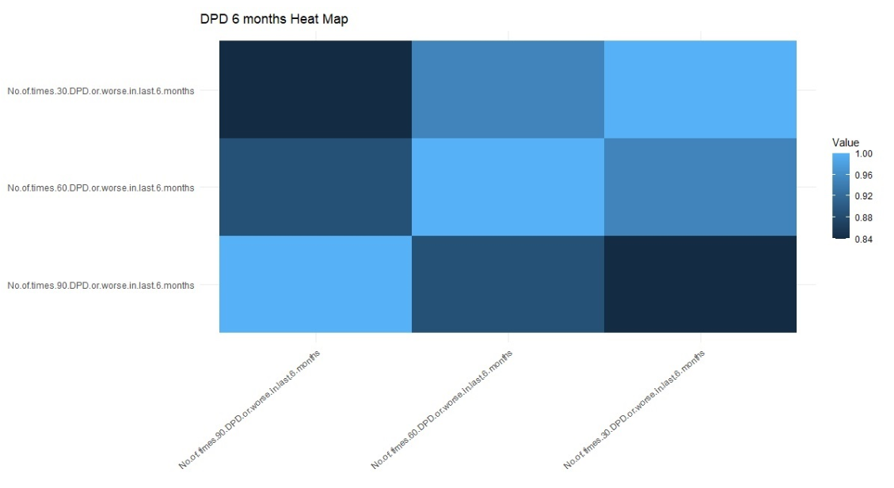
Correlation Analysis
Correlation of DPD Variables for 30, 60, 90 DPD cycle has been done
Correlation between these variable created for 6 Month DPD duration
From the above heat Map we can conclude that light blue = 1 is the relationship of variable with itself.
Dark blue color=0.84 shows the negative relationship between the variables
For 6 Months 30DPD and 60DPD average relationship.
For 6 Months 30DPD and 60DPD has significant negative relationship and more towards 0.80 value Dark Blue
30 DPD
60 DPD
90 DPD
90 DPD
60 DPD
30 DPD

Slide 12
MODEL BUILDING
OUTLIER TREATMENT:
n/a’s were removed. It was determined that with such a large sample set, and the relatively low accuracy, removing outliers was not necessary.
The data was pre-processed using the WOE methodology.
DATA SAMPLING:
The given data is highly imbalanced.
The ROSE data sampling package was used to balance the dataset.
Training Data (before ROSE):
Non-defaults: 52,517
Defaults: 2,334
Training Data (after ROSE):
Non-defaults: 27,325
Defaults: 27,462
Test Data:
Non-defaults: 13,422
Defaults: 565

Slide 13
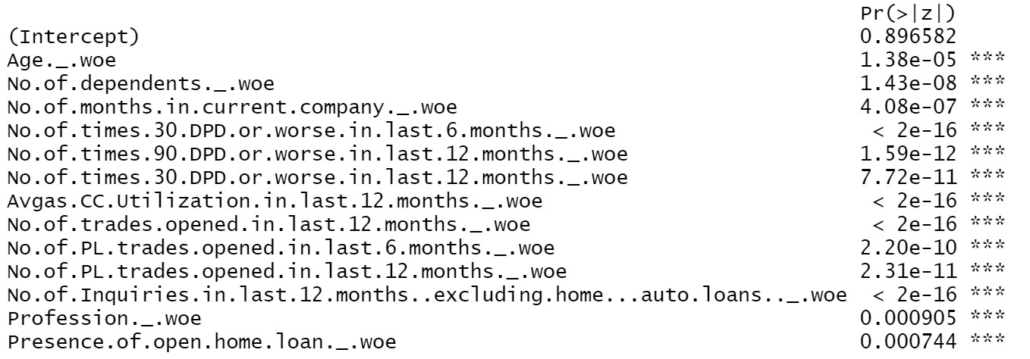
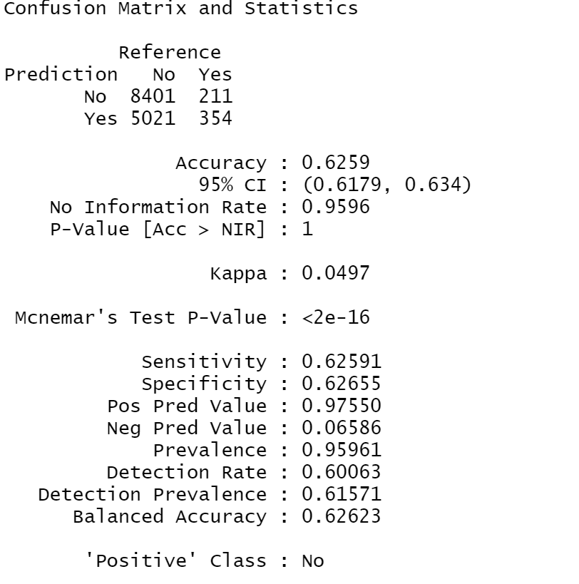
LOGISTIC REGRESSION
Important Predictors & Model Statistics:
Confusion Matrix
Statistics | Values
Cut-off | 0.1
Accuracy | 92.7%
Sensitivity | 95.9%
Specificity | 9.6%

Slide 14
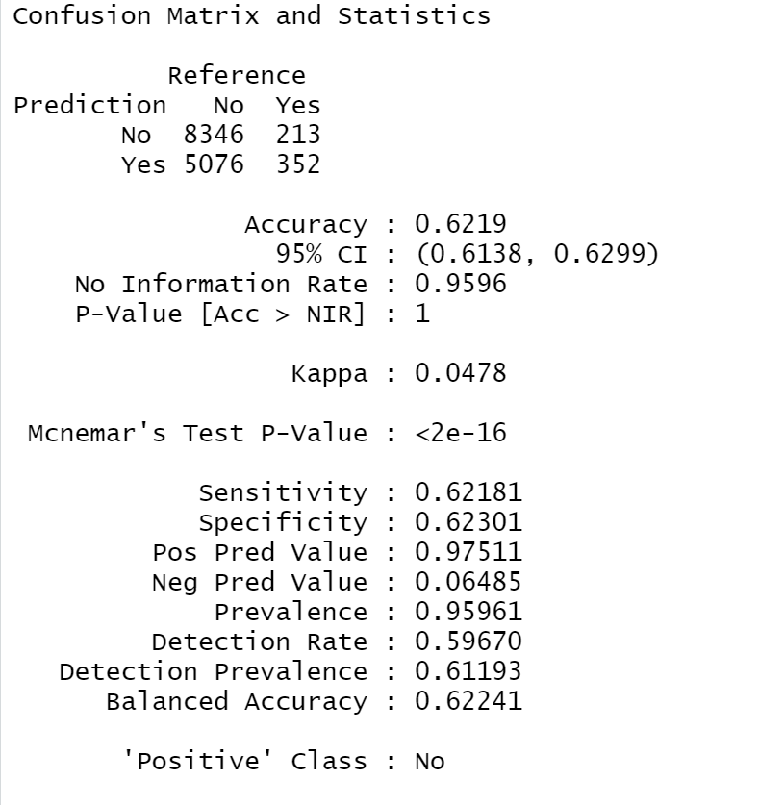
RANDOM FOREST
Important Predictors & Model Statistics:
The random forest modelw as built with the same parameters as the Logistic Regression
Limitations on running were hit. Only 100 trees were able to be run. Models of larger size were not psossible
Confusion Matrix
Statistics | Values
Cut-off | 0.1
Accuracy | 92.7%
Sensitivity | 95.9%
Specificity | 9.6%

Slide 15
Support Vector Machine
Support Vector Machines are sturggling to run on my computer
Dataset redced significantly, 5% of nondefaults, 80% of defaults
Linear and radial kernels were run, linear results were better, so they are communicated below
Polynomial kernels were not able to compute on my machine
Tuning was not able to compute on my machine
Oveerall, results are not as good as Random Forest
Statistics | Values
Cut-off | default
Accuracy | 83.3%
Sensitivity | 83.8%
Specificity | 30.0%

Slide 16
Comparison of Models
The Random Forest and Logistic Regression give comparable results. The SVM model was never fully developed due to technical limitations, so it does not perform at the same level.

Slide 17
Conclusion
There remain significant concerns with the modellign accuracy and the tools with which we have to analyze the data are limited.
SVM analysis isn't really possible with the dataset. The Random Forest Dataset gave the most promise, though the accuracy is still quite low with only 39% for specificity and sensitivity.

